Slide 1
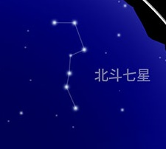
Learning More about Stars & Constellations
〇 Let’s Learn Old Constellations
In the past as well as the present, Zodiac signs such as Sagittarius and Gemini, and constellations like Orion, have been used by humans to add astrological meanings to birth dates and to tell fortunes. In 1922, the 88 constellations visible in the sky from Earth were recognized by the International Astronomical Union (IAU).
Until then, constellation patterns formed from different stars, or by connecting the same stars into different patterns, had various names depending on the countries or regions.
Many constellations also related to myths and legends that have been passed down since ancient times.
Let’s learn what constellations existed in the past, their shapes and names, and the stories and origins behind how those constellations were created.
Kajiboshi
The Big Dipper, located in the Ursa Major constellation, is famous as a landmark for finding Polaris. The name “Big Dipper” is known to be of Chinese origin. In addition, it has Japanese names of everyday items, such as Kajiboshi (“Rudder,” to fishermen), or Tsurukake (“Hook”).
As you can see, even the same constellation can be called differently depending on regions and/or occupations.
Septentrions
Big Dipper
Tsurukake
© NAOJ
Translation by JAXA

Slide 2
〇 Tell Us about a Constellation You Have Learned
Draw a picture of how the stars in constellation which you learned are connected and what shape they form
Constellation’s name:
What did you learn about the story behind the constellation you learned? Why/how was it created?
(If the box below is not big enough for your work, try putting it on a separate piece of paper)
© NAOJ
Translation by JAXA

Slide 3
〇 Comparing Old vs New Constellations
Compare the name and shape of the constellation you have actually learned with the constellation of today
Past
Present
Name:
Name:
Find out differences between the stars that make up the constellation and how they relate to the past and present
© NAOJ
Translation by JAXA

Slide 4
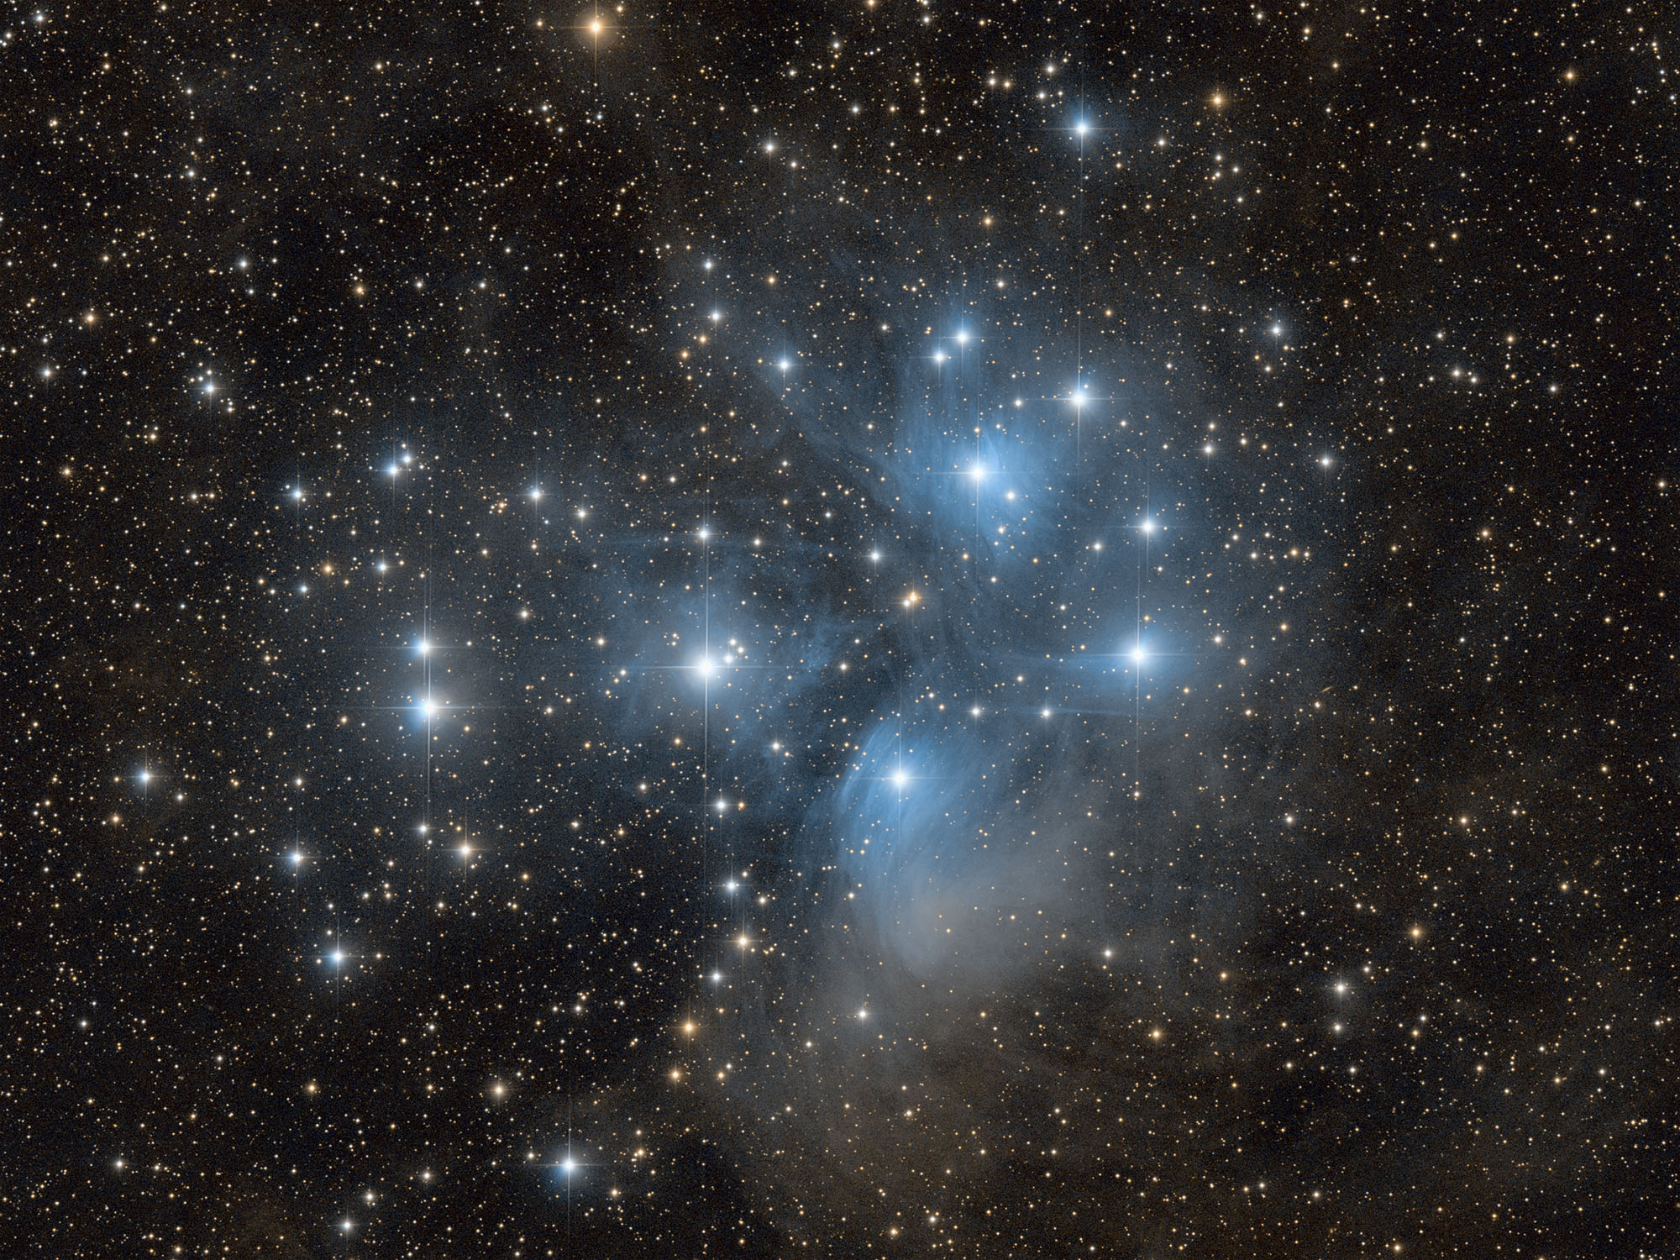
〇 Advance: Learn about the Past and Present of Stars
In addition to constellations created by connecting parts of modern constellations, there are also some stars or star groups that had different names than they do now.
For example, the Pleiades (M45), located in the constellation Taurus, is one of the most famous star clusters.
In Japan, the Pleiades was featured in the famous "The Pillow Book" written by Sei Shonagon by it’s Japanese name, Subaru. It is called “Mao Xiu” in China. It is also known as the “Seven Sisters” from Greek mythology. It has various names even within Japan, for example, Mureboshi in the Okinawa region.
The Pleiades
Murikabushi
Mao Xiu
Seven Sisters
Subaru
© NAOJ
Translation by JAXA

