Slide 1
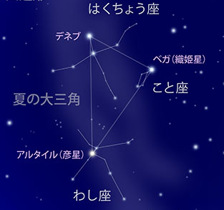
Let’s take a look at the Summer Triangle and see how it moves
〇 Finding the Summer Triangle
On summer nights, you can look up and see the stars shining. The brightest of these appear in different constellations. Take a closer look and you will see that three of them stand out from the rest.
These stars are Vega in the Lyra constellation, Altair in Aquila (in the southern sky) and Deneb in Cygnus (in the northern sky) all just above the Zenith. If you draw a line between all three stars, they form the Summer Triangle.
North
Cygnus
Look at the diagram on the left and see if you can find the Summer Triangle.
Deneb
Vega (Orihime)
Summer Triangle
Lyra
East
West
Altair (Hikoboshi)
Aquila
South
In Japan, two out of the three stars of the Summer Triangle, Vega in the Lyra constellation and Altair in the Aquila constellation are known as Orihime and Hikoboshi, the star-crossed lovers in Japan’s famous Tanabata folktale.
“Tanabata”:
The story of Orihime and Hikoboshi
Translation by JAXA
(C) NAOJ

Slide 2
〇 Let’s draw and see how the Summer Triangle moves
(C) NAOJ Translation by JAXA
Using the buildings, trees, etc. around you as reference points, draw a picture of the Summer Triangle’s location.
M/D: __/__ Time: __:__ a.m. / p.m.
From the same location, draw pictures of the Summer Triangle at different times on the same days, or at the same time on different days.
M/D: __/__ Time: __:__ a.m. / p.m.
If you would like to observe more than two times, you can copy this page and use it.

Slide 3
〇 Let’s compare the drawings
Write down how the Summer Triangle changed on different date and time from your fixed location.
〇 Challenge: Let’s view the picture against the northern sky
The Summer Triangle is visible from the eastern to the southern sky.
Now let’s take a look toward the northern sky at the North Star and observe the movements of the stars around it.
How do the movements of the stars around the North Star compare with the movement of the Summer Triangle?
？
？
Summer Triangle
Northern Sky
Translation by JAXA
(C) NAOJ

